Slide 1
Browsing Using ListBox, Find,
… & Delete considerations
David Turton
Conestoga College
Institute of Technology and Advanced Learning
dturton@conestogac.on.ca
Doon 2A605 x3610

Slide 2
Browsing & Delete
Use a list box to select records
Find a record based upon a value entered by the user
Delete records
Handle an empty database

Slide 3
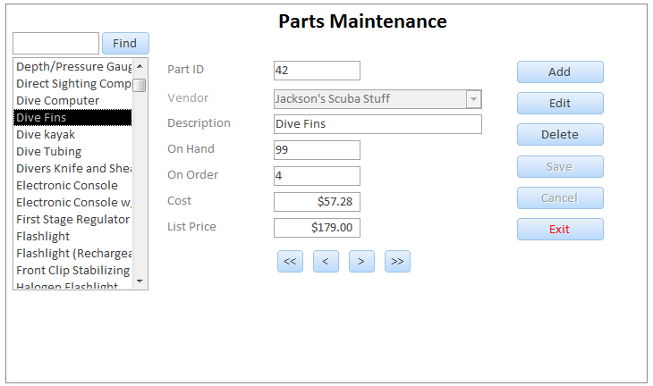
Using a list box for selecting records
Listbox:
  User-friendly descriptive field
  In most logical order for user
User clicks on desired record
Your code displays record's details

Slide 4
Hint:
You can’t do “Next” on a ListBox
The ListBox is for the user to select from
  In code, its Click event handler translates:
    Find the record in the recordset with the selected key
    Populate the form from the current record in recordset
Your code can’t move the ListBox index
… so …
  Navigation buttons move the recordset pointer
  The new key is pushed back to the ListBox
    It just looks like the program moved the ListBox selector.

Slide 5
Listbox for selecting records
Listbox properties:
  Data | row source type: table/query
  Data | row source: typically a query, sorted
    at least two fields (key + descriptive field)
    good design: the key field is the first field
  Data | bound column: the key col. (i.e. 1)
  Format | column count: 2
    Key & descriptive field
  Format | column widths: 0”; 1”
    zero to hide key column

Slide 6
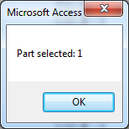
Listbox displays customer name
… but returns customer key
Important to bind to column containing the key field
  The value of the listbox control is the value of the bound column
For example: user selects Dive kayak in listbox.
  The listbox’s value is the corresponding PartID (hidden key field)
Check, by adding to lstParts_Click():
MsgBox "Part selected: " & lstPartId.Value
Value of the listbox is the key field PartID, not the displayed field Description

Slide 7
Listbox for selecting records
Add a listbox to the form
  Fill it using a query
    Sort displayed (part name, customer name)
    Return the primary key of the selected item
  Enabled in browse mode, disabled in modify mode
Add code to the click event of the listbox
  Go to start of the recordset before doing a find
    .moveFirst method
  Use .Find to find record in the recordset by key
    Find only looks forward in the recordset
  Use PopulateForm( ) to fill the form

Slide 8
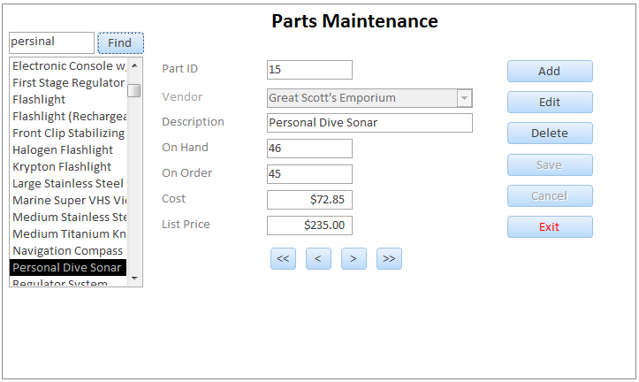
Textbox for selecting records listbox & recordset should be sorted by search field
Textbox to search by Description
User clicks the Find button:
  Locate record equal to or greater than the value entered
User can enter partial names
  User types "T":
  locate first record beginning with T
  … or greater, if no T’s
Hint: .Find only looks forward from the current point in the recordset

Slide 9
Textbox for selecting records
.Find method
partsRecordSet.Find("fieldName = " & value)
criteria string
Sample criteria strings
"PartID = " & txtPartId
"description >= '" & txtFind & "'"
Build criteria Strings using concatenation (&)
Note single quotes around string values

Slide 10
Search String: Quotes
String values need to be in quotes
"description >= "Compass""
But can’t use doubled quotes inside criteria string
XXX.Find "description >= "" + txtDesc + """
How to nest quotes?
  use single within double
  "description >= 'Compass' "
XXX.Find "description >= '" & txtDescription & "'"

Slide 11
Problem:
Handling imbedded single quotes
Issue: What if you are searching for a name that contains a single quote?
if use the following code to find a 1'pole XXX.Find ("description >= '" + txtDescription + "'")
the resulting criteria string would be:
"description = '1'pole'"
Presence of second single quote will end the search string so pole will be ignored

Slide 12
Replace input single-quotes
Solving the nested quote problem
There are several ways around this in different languages.
Replace the single quote in the search string with a doubled single quote
  VB interprets two single quotes as just one single quote
  i.e. change 1' pole to 1'' pole
Replace function:
  replace all occurrences of a string with an alternative string.
Replace(expression, find, replace )
Replace (description, " ' ", " ' ' ")
replace a single quote (shown inside double quotes)
with two single quotes (shown inside double quotes)
xxxx.Find "Description >= '" + Replace(…you fill it in…) + "'"
the resulting criteria string would be:
"description = '1'' pole'" which will work! ☺

Slide 13
Textbox for selecting records
Add code to the click event of Find button
  .Find field in recordset >= value of textbox
    Changes current record pointer's position
  Use PopulateForm( ) to fill the form’s textboxes with the current record’s values
    Push key back as value of ListBox
      Keeping it in sync

Slide 14
What if value not found?
i.e. - user enters Wilson in text box and the
last name is "Turton" (< Wilson)
- .Find with name >= Wilson… fails
Do a .Find, then test for not found:
  .EOF = true
So where do you leave the user?
  Probably customers.MoveLast

Slide 15
Deleting a Record
Add a Delete button
This button will be enabled when in what state?
Browse Mode
The method to delete a record from the parts recordset is?
partsRecordset.Delete

Slide 16
Deleting
Issue: After the delete what record should be current?
Current record to be deleted
bof
a
b
c
d
e
f
g
eof
The record after the deleted one would be fine
bof
a
b
c
d
f
g
eof

Slide 17
Deleting
How to do this:
  Before deleting, save the lastName field into a variable
      saveLastName
bof
a
b
c
d
e
f
f
g
g
eof
eof
    Do the delete
  Do a requery to refesh the recordset (this causes the record pointer to move to the first record in the recordset)
  you already have a routine to find a record based on lastname in the txtFindName control so use it!
    move the saveLastName to the find text box and call the BtnFind_click routine

Slide 18
Deleting
Issue: What if you delete the only remaining record?
after the delete – empty recordset
Current record to be deleted
bof
a
eof
bof
eof

Slide 19
Detecting an empty Database
When:
As soon as form loads
After delete and requery
After cancel
  canceling an add with no records in the db
How:
test for EOF and BOF
  Both are true if there are no records

Slide 20
How to handle an empty Recordset
What actions can a user do when the there are no records? (i.e. What buttons should be enabled?)
only Add and Exit

Slide 21
EmptyState( )
Clear form
Call BrowseMode(True)
Disable even more buttons:
  Only two buttons left – Add & Exit
Display a message on screen “no records”
Call this routine whenever an empty recordset is detected (refer to "when" on previous slide)

Slide 22
Detecting an empty Database
… alternate …
Who chokes on an empty database?
  All navigation buttons
  PopulateForm
What actions are logical?
  Show an empty form?
    …what will you do with navigation, listbox, find, etc.?
  Go directly to Add state?
    All navigation is locked … can't close form, though
Where do you decide this?
  Form load calls PopulateForm
  Delete & Cancel call PopulateForm
  → got the idea? ←

